Slide 1

Macroeconomic Objectives
Growth
3.3
Copyright Bananaomics

Slide 2

What are the 3 main objectives of an economy?
Copyright Bananaomics

Slide 3

3 Macro Objectives
  Economic Growth
  Low Unemployment Rate
  Low and Stable Inflation
Possible additional goals: Sustainable Debt, Equity, and Income Distribution
Copyright Chandler Bell

Slide 4

Definition
Economic Growth
Increase in real GDP over time
Copyright Bananaomics

Slide 5

Growth
Growth can be represented using a PPC or AD/AS diagram.
Short-term growth is an increase in actual output while long-term growth is an increae in potential output.
Copyright Bananaomics

Slide 6
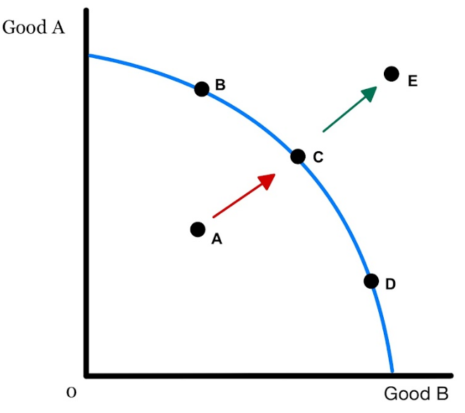


Short-Term Actual Growth
A movement from point A to Point C illustrates ACTUAL GROWTH.
ACTUAL GROWTH - When growth/efficiency is achieved by making better use of resources.
This is growth that can ACTUALLY happen given current resources.
Copyright Bananaomics

Slide 7
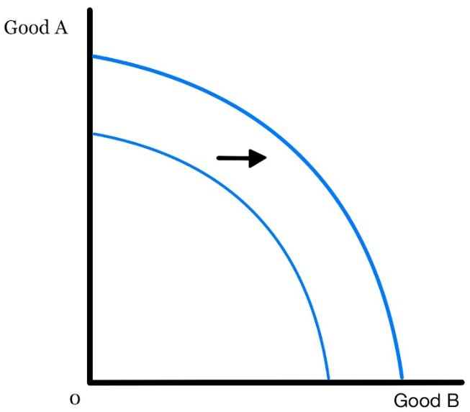

Long-Term Potential Growth
An increase in the maximum amount that can be produced is POTENTIAL GROWTH.
POTENTIAL GROWTH results in a shift of the PPC. A few things cause the shift of PPC.
Shifters of the PPC (Potential Growth)
1. Change in quantity or quality of Factors of Production
2. Improvement in Technology
Copyright Bananaomics

Slide 8
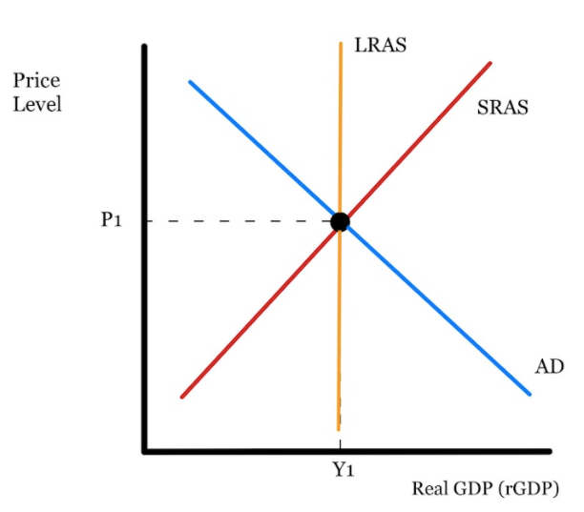
Using an AD/AS diagram draw actual vs potential growth
Copyright Bananaomics

Slide 9
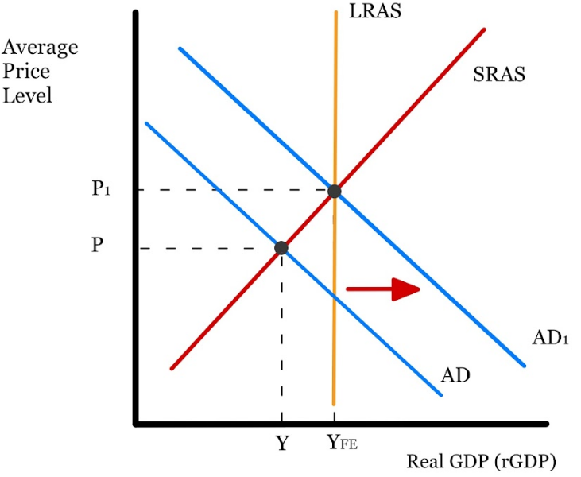
Actual Growth
Copyright Bananaomics

Slide 10
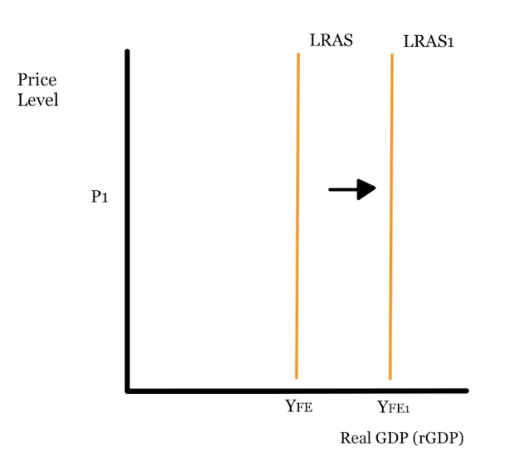
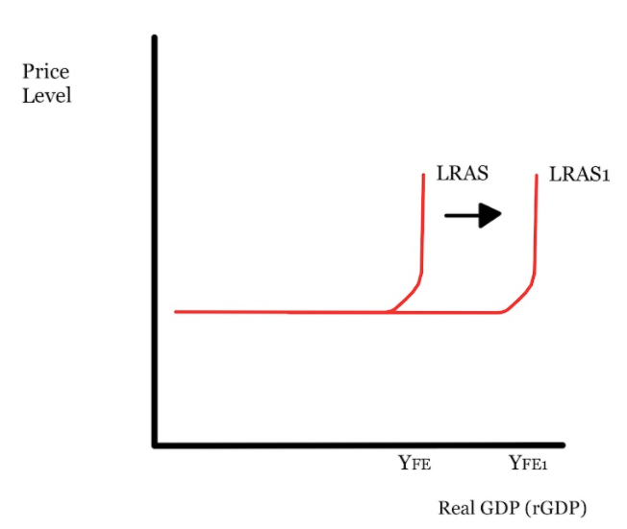
Potential Growth
Copyright Bananaomics

Slide 11

Measuring Economic Growth
Copyright Bananaomics

Slide 12
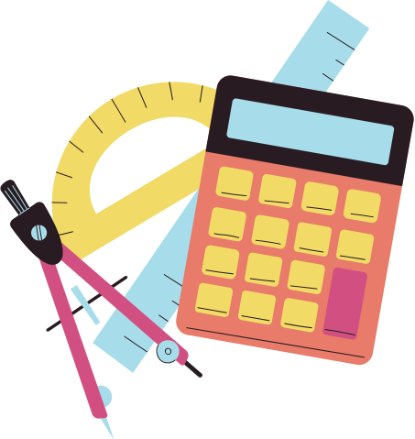
Formulas
To measure economic growth, just use percent change.
Economic Growth
new RGDP - old RGDP
x 100
old RGDP
Copyright Bananaomics

Slide 13

UNDERSTANDING ECONOMIC GROWTH | AP MACROECONOMICS | KHAN ACADEMY
Copyright Bananaomics

Slide 14

Consequences of Economic Growth
  Impacts on Living Standards
    An increase in RGDP typically leads to an increase in people's income leading to better living standards
  Environmental Impacts
    If economic growth is the primary concern of a country, sustainability typically is pushed by the wayside
  Income Equality and Distribution
    Depending on the status of wealth and income equality in a country, economic growth may only help certain groups of individuals such as the wealthy and elite while actually harming low-income earners
Copyright Bananaomics

Slide 15

Enjoying The Content?
Visit bananaomics.com to purchase package deals with discount prices!
BANANAOMICS

